Slide 1
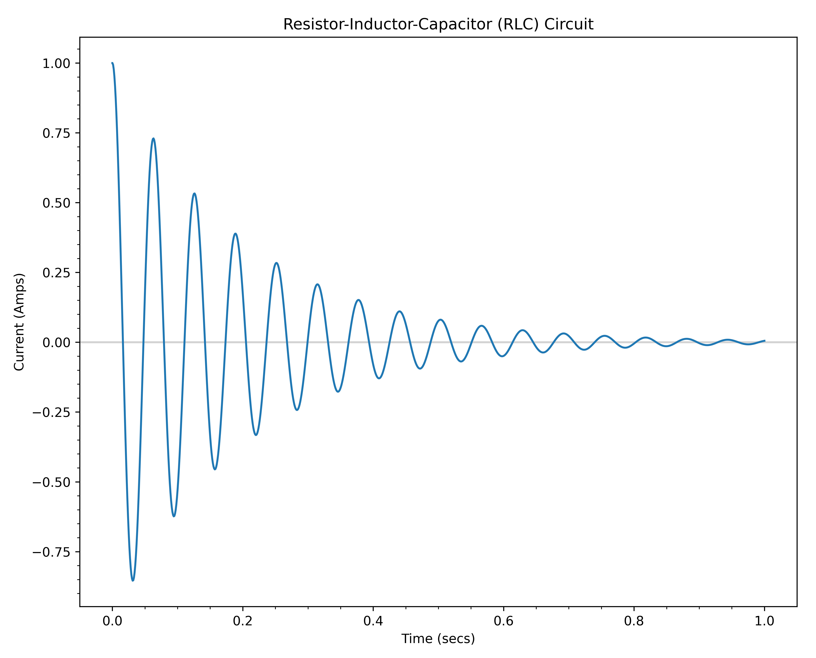
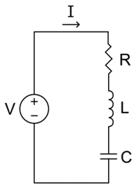
Session 05 – Task 04
Every RLC circuit has a certain fundamental frequency in which it oscillates based upon its
L and C values

Slide 2
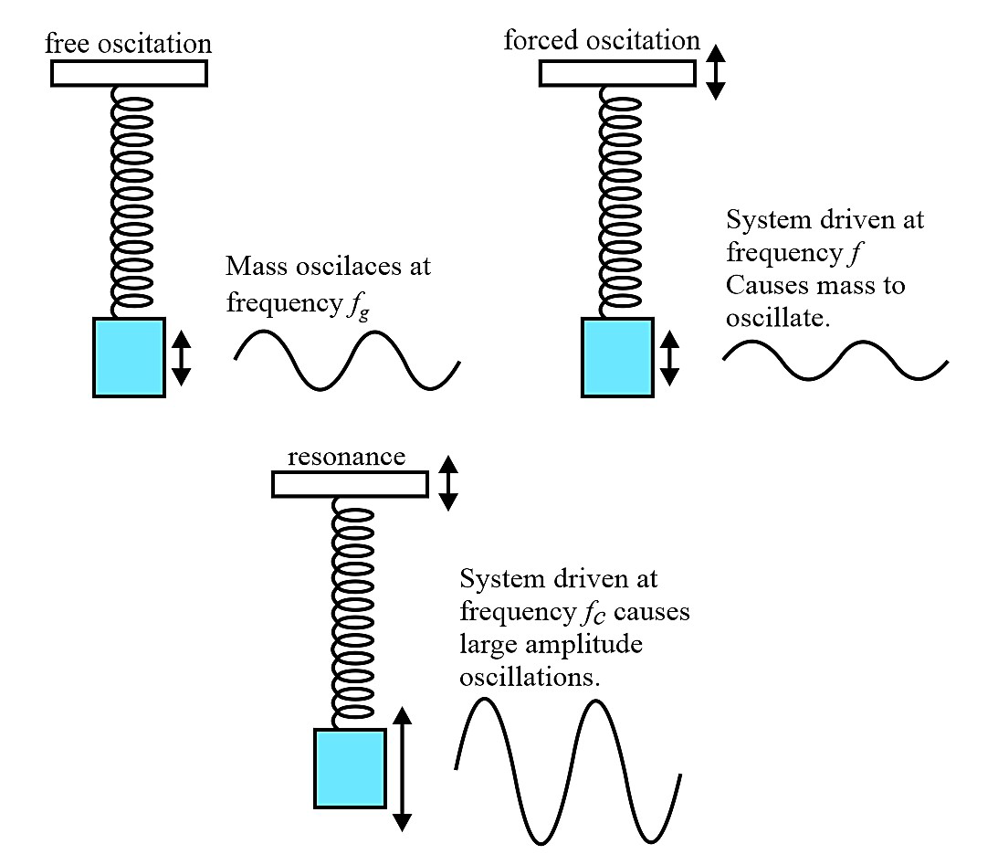
Driven Oscillators - Resonance

Slide 3
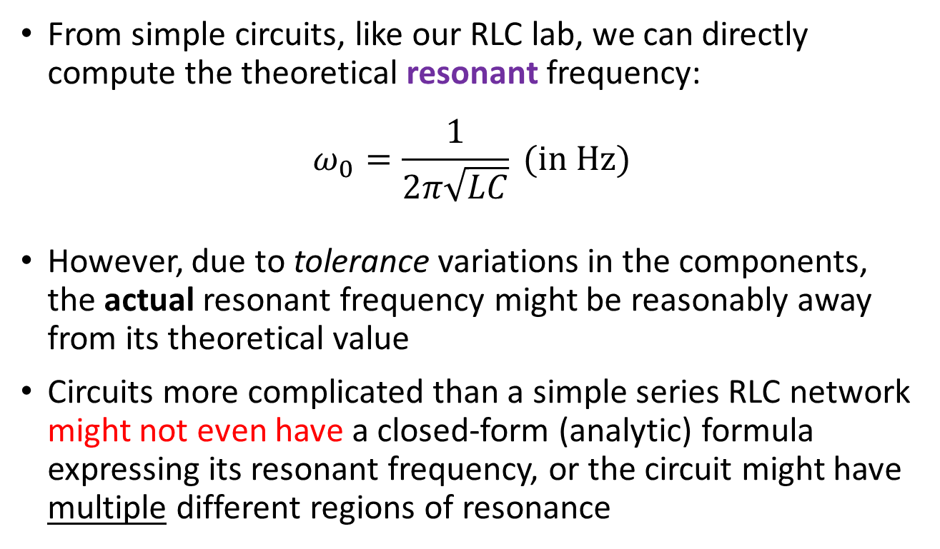
Finding a Circuit's Resonant Frequency
From simple circuits, like our RLC lab, we can directly compute the theoretical resonant frequency:
$$ω_{0}=\frac{1}{2π\sqrt{LC}} (in Hz)$$
However, due to tolerance variations in the components, the actual resonant frequency might be reasonably away from its theoretical value
Circuits more complicated than a simple series RLC network might not even have a closed-form (analytic) formula expressing its resonant frequency, or the circuit might have multiple different regions of resonance

Slide 4
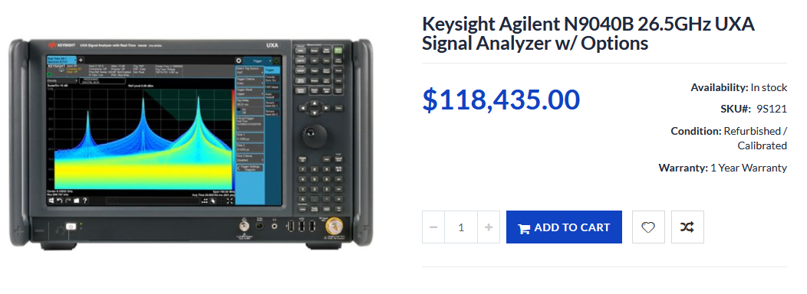
Finding a Circuit's Resonant Frequency
☹
Let us see if we can use a KB2040 to determine the resonant frequency of an RLC circuit
But first, let's simulate in software (via a mathematical model) our RLC circuit being driven by an AC voltage source…

Slide 5
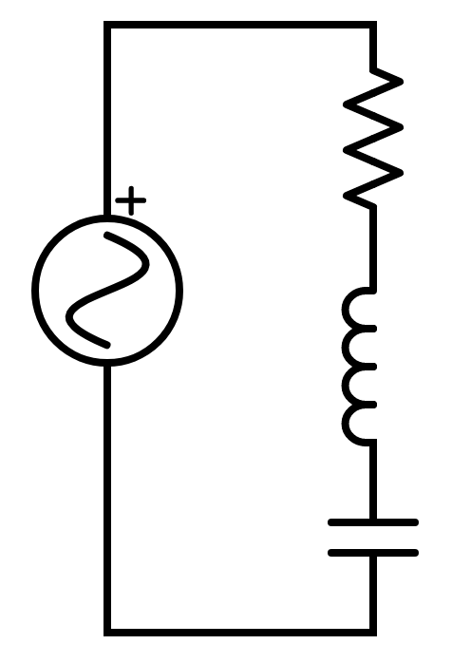

















Simulating a Driven RLC Circuit
$$ε=EMF=+1.21V$$
$$V_{s}=ε\sin\left(ωt\right)$$
AC Voltage Source
$$V_{R}=IR$$
Ohm's Law
Voltage across the resistor
10.05Ω 99.32Ω
R
$$V_{L}=L\frac{ⅆI}{ⅆt}$$
Faraday's Law
S
$$V_{C}=\frac{Q}{C}$$
Gauss's Law
100.8mH
L
$$V_{s}=V_{R}+V_{L}+V_{C}$$
Kirchhoff's Voltage Law
91.2
uF
C
Euler's Method
$$V_{s}=IR+L\frac{ⅆI}{ⅆt}+\frac{Q}{C}$$
$$Q_{n+1}=Q_{n}+I_{n}ⅆt$$
$Q=$ Charge (in Coulombs)
$$V_{s}=IR+Lα+\frac{Q}{C}$$
$$I_{n+1}=I_{n}+αⅆt$$
$I=$ Current (in Amps)
$$V_{n+1}=V_{n}+IR$$
$$\frac{ⅆQ}{ⅆt}=I$$
$$\frac{ⅆI}{ⅆt}=α$$
$$α=\frac{\left(V_{s}−IR−Q/C\right)}{L}$$
$$t_{n+1}=t_{n}+ⅆt$$

Slide 6
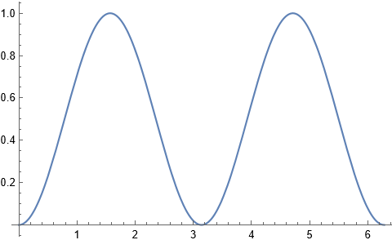

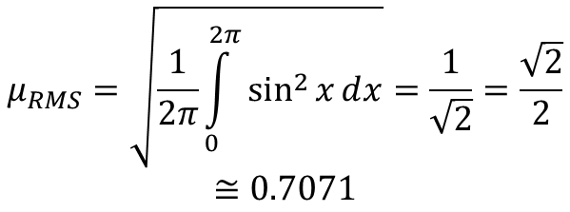


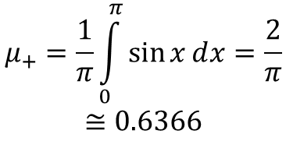
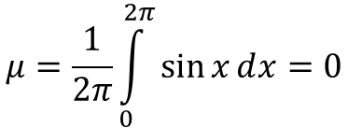

Root Mean Squared (RMS) vs. Mean
$$\sin^{2}{x}$$
$$μ=\frac{1}{2π}\int_{0}^{2π}{\sin{xⅆx}}=0$$
☹
$$u_{RMS}$$
$$u_{+}$$
$$μ_{+}=\frac{1}{π}\int_{0}^{π}{\sin{xⅆx}}=\frac{2}{π}$$
$$≅0.6366$$
😐
$$2π$$
$$μ_{RMS}=\sqrt{\frac{1}{2π}\int_{0}^{2π}{\sin^{2}{xⅆx}}}=\frac{1}{\sqrt{2}}=\frac{\sqrt{2}}{2}$$
$$≅0.7071$$
Mean is used to get the central tendency of a given data set while RMS is used when random variables given in the data are both negative and positive such as in sinusoids
☺

Slide 7
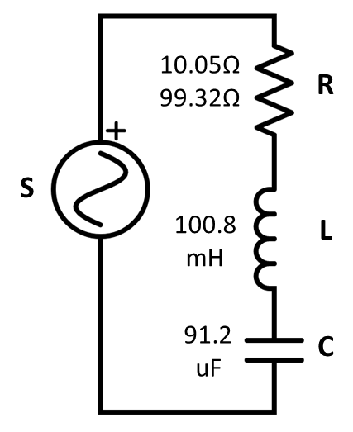
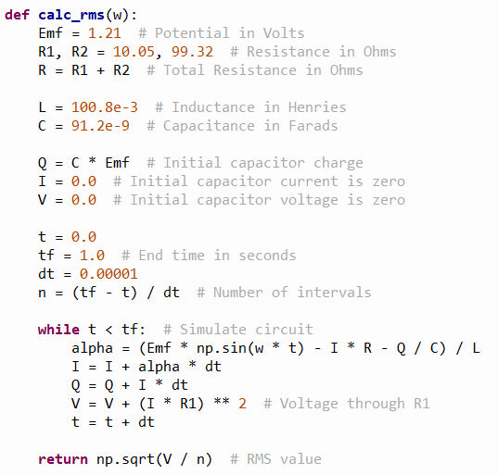
Open driven_rlc.py
①
②
③
④
⑤
⑥
⑦
⑧
⑨
⑩

Slide 8
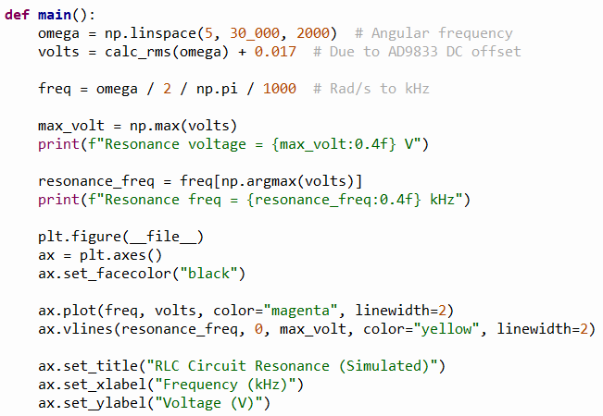

View driven_rlc.py
①
②
③
$$ω=2πf$$
$$1Hz=1000 kHz$$
④
⑤
⑥
⑦
⑧
⑨

Slide 9
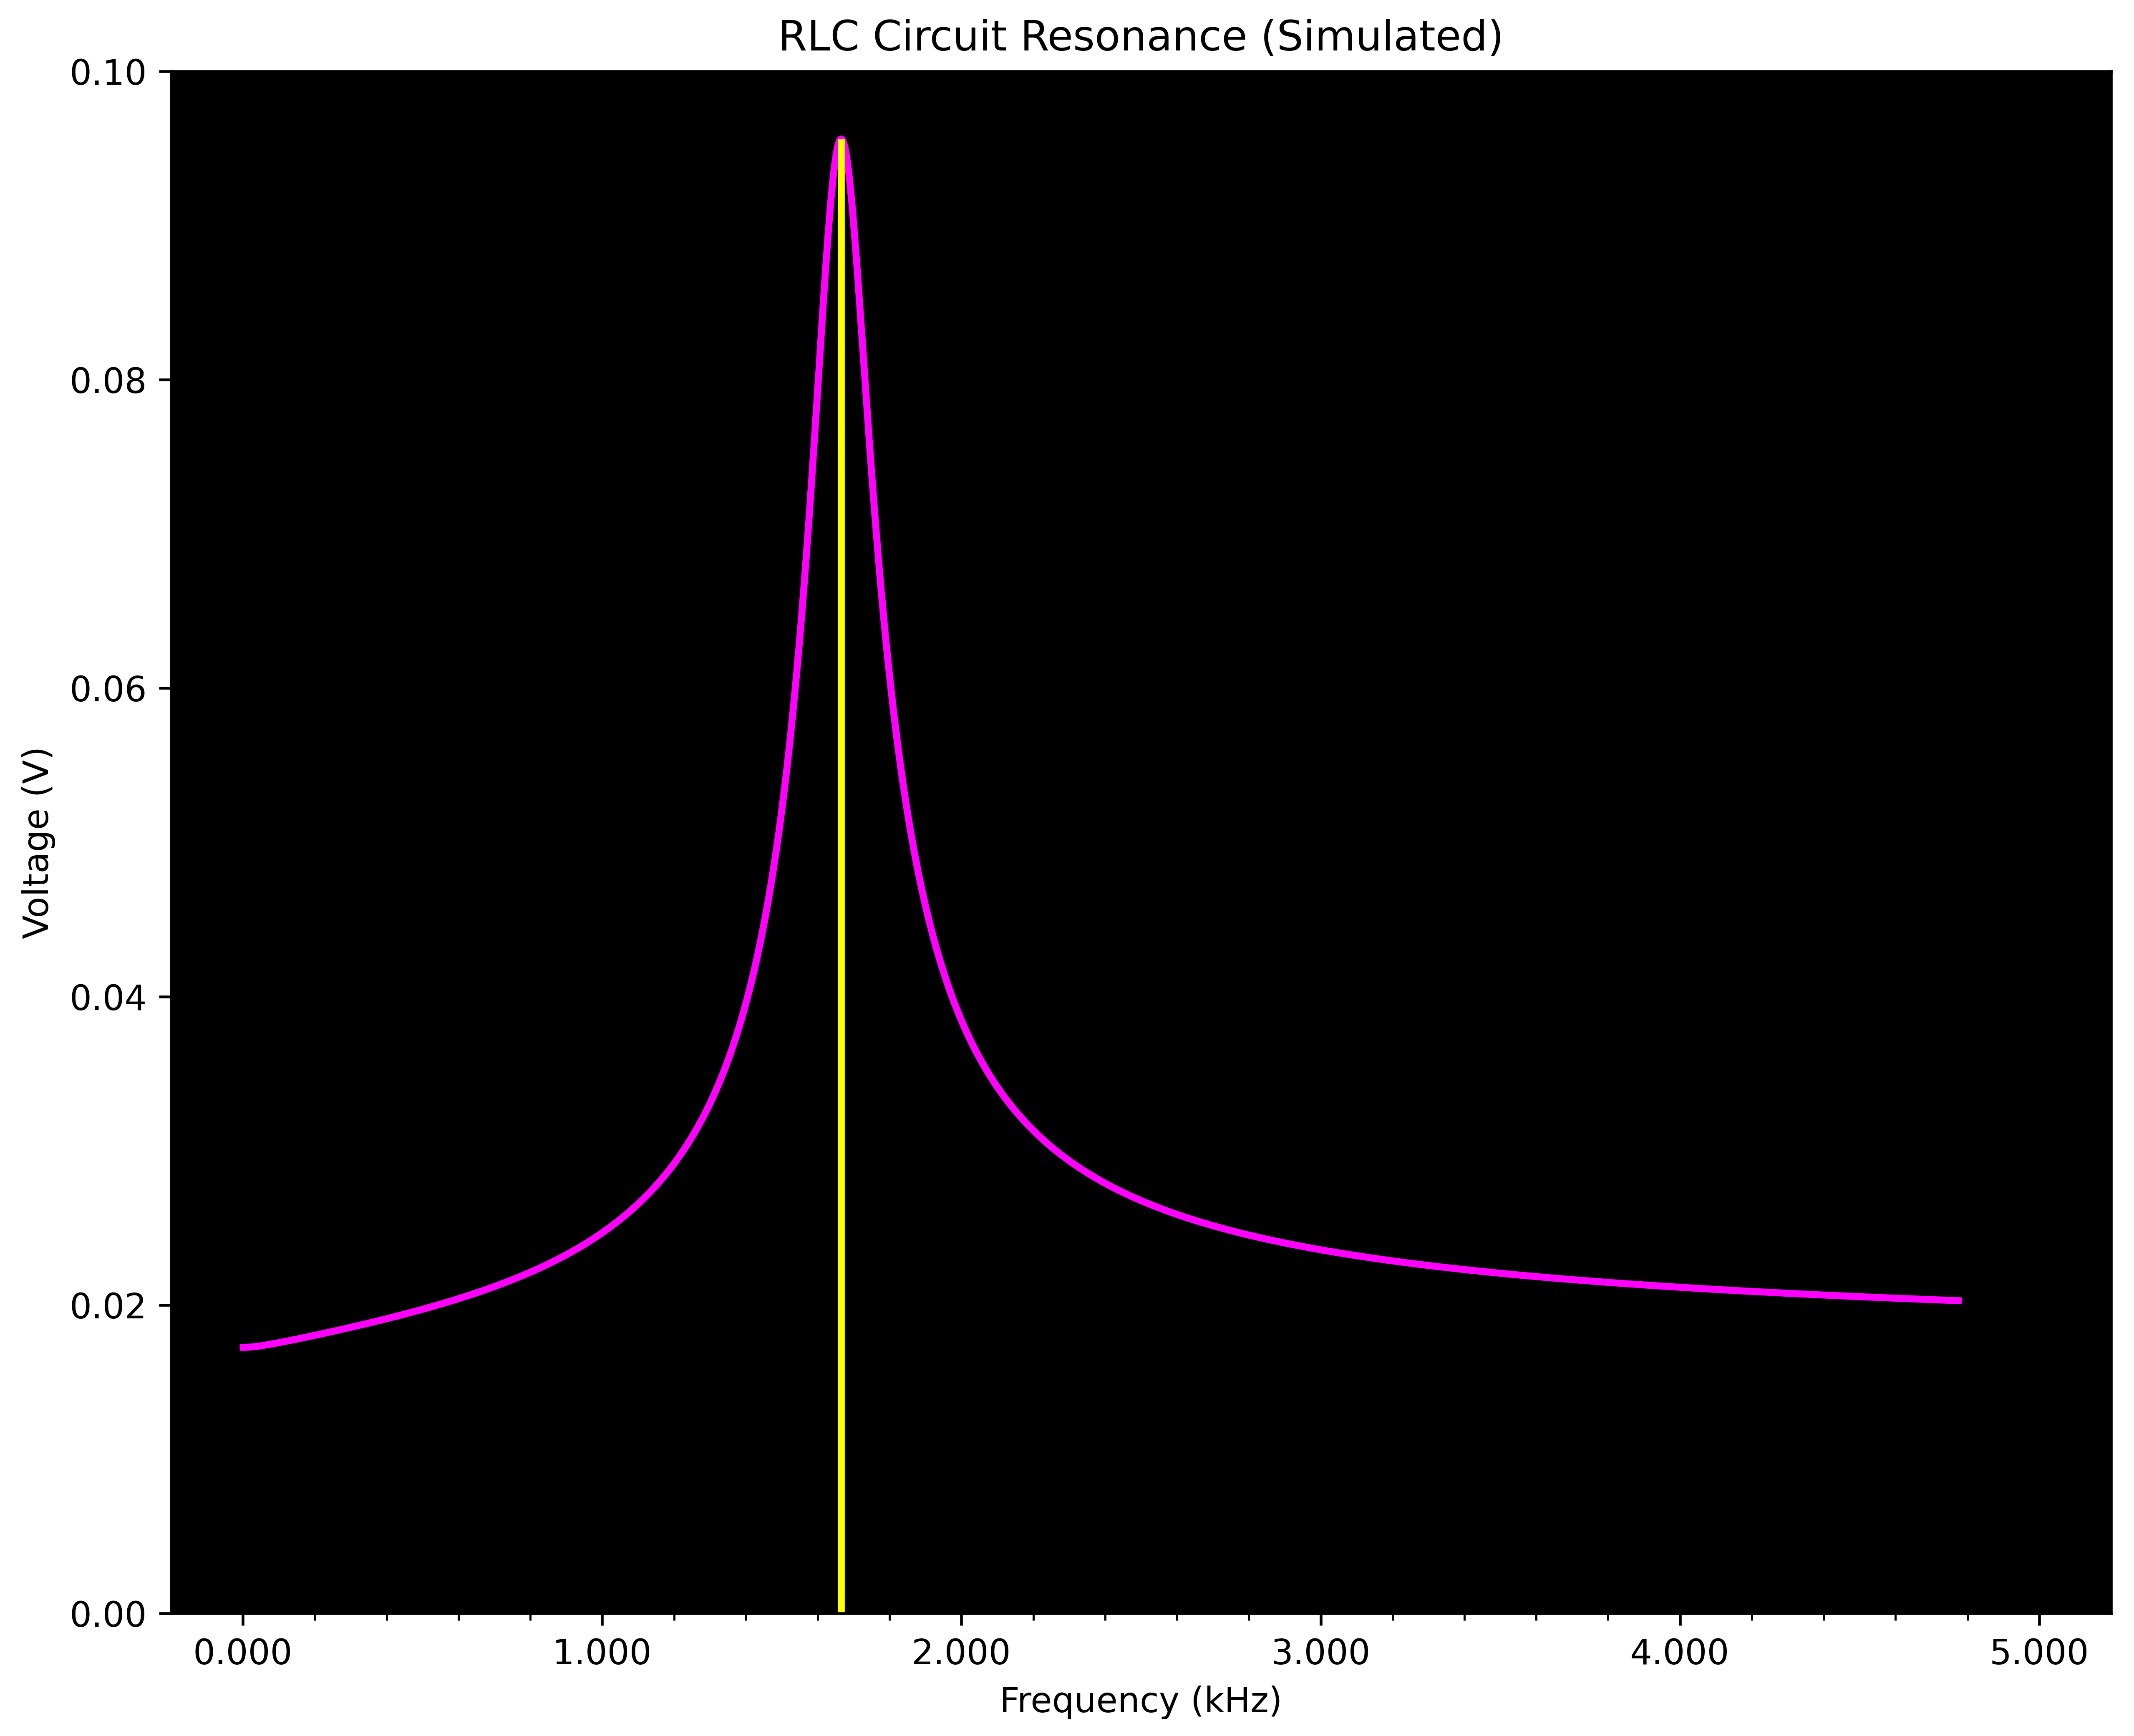
Run driven_rlc.py

Slide 10
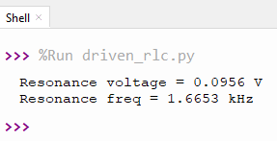
Run driven_rlc.py
At resonance, the LC elements have nearly zero resistance, so the current (and hence voltage) flowing through R1 (and R2) would be at the maximum

Slide 11


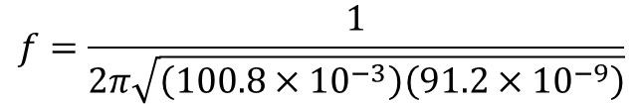


Check driven_rlc.py
$$ω=\frac{1}{\sqrt{LC}}$$
$$f=\frac{1}{2π\sqrt{\left(100.8×{10}^{−3}\right)\left(91.2×{10}^{−9}\right)}}$$
$$f=\frac{ω}{2π}$$
$$f=\frac{16599 Hz}{1}×\frac{1 kHz}{1000 Hz}=1.6599 kHz$$
$$f=\frac{1}{2π\sqrt{LC}}$$
Euler's Method is only 1st order accurate and susceptible to stability issues with oscillating signals
😐

